Slide 1
Dream/Wakefulness classification through LLM
Enzo Gerbelot-Legris

Slide 2
Bizarreness in dreams
Exploration on Célia’s work on pareidolia :
The processing path :
I wanted to explore different creative group by types of creativity or pareidolia content.
Bizarreness = Unusual features of dream experience.
Bizarreness linked to weak constraints on deliberate thought and maybe link to creative mind.
Bizarreness find in mind wandering and dream. link with pareidolia?

Slide 3
Bizarreness in dreams
Questions of interest :
Exploring the link between high creative and low and the score of bizarreness in dreams or/and mind wandering.
A cerebral signature of bizarreness ?
Differences in bizarreness density and bizarreness subtypes during sleep stages and mind wandering ?
Using the Dream and EEG mentation database (505 participants, 2643 awakenings in different sleep stages).
Bizarreness score comparison between human scorer vs AI Claude.

Slide 4
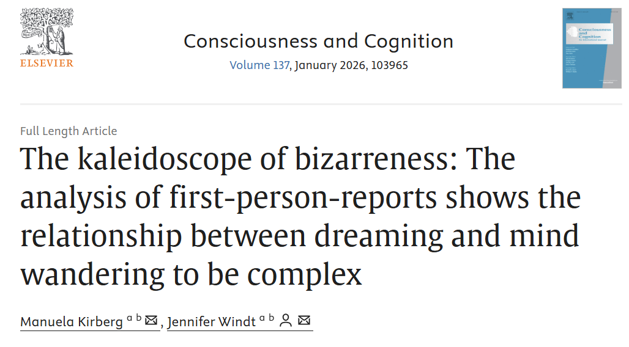

Slide 5

Standard refined definition of bizarreness that can fit for both dreams and mind wondering experiences
Bizarreness density to avoid biases of report length
first study to use content analysis of free reports

Slide 6
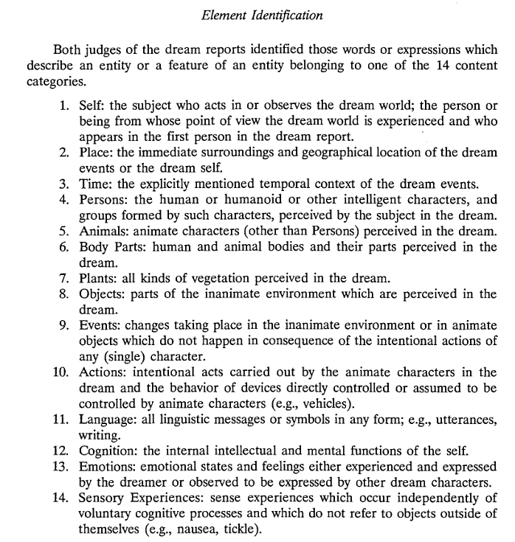

Slide 7
« Hier j’étais dans un château »
« Hier j’étais dans un château »
Time Self Place

Slide 8
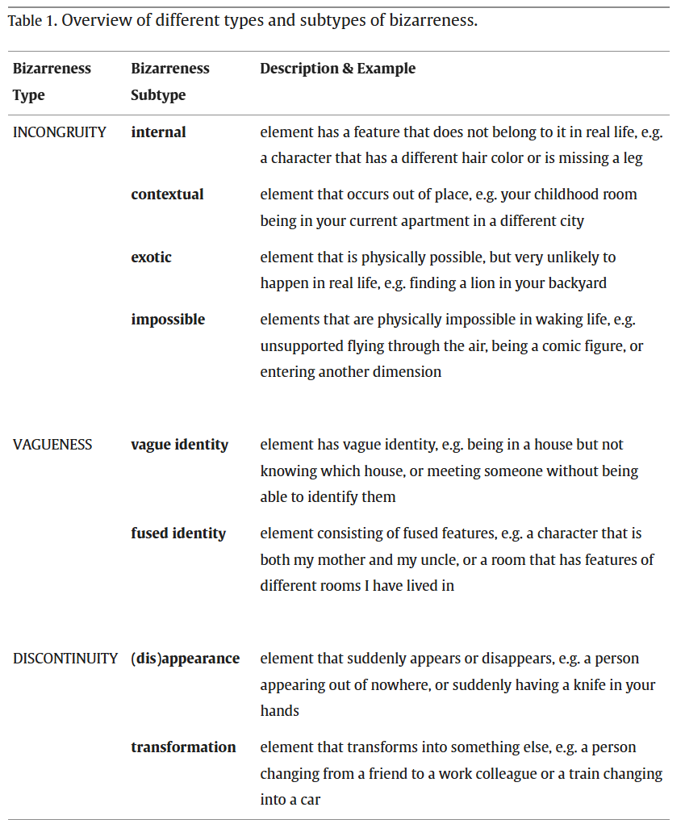

Slide 9
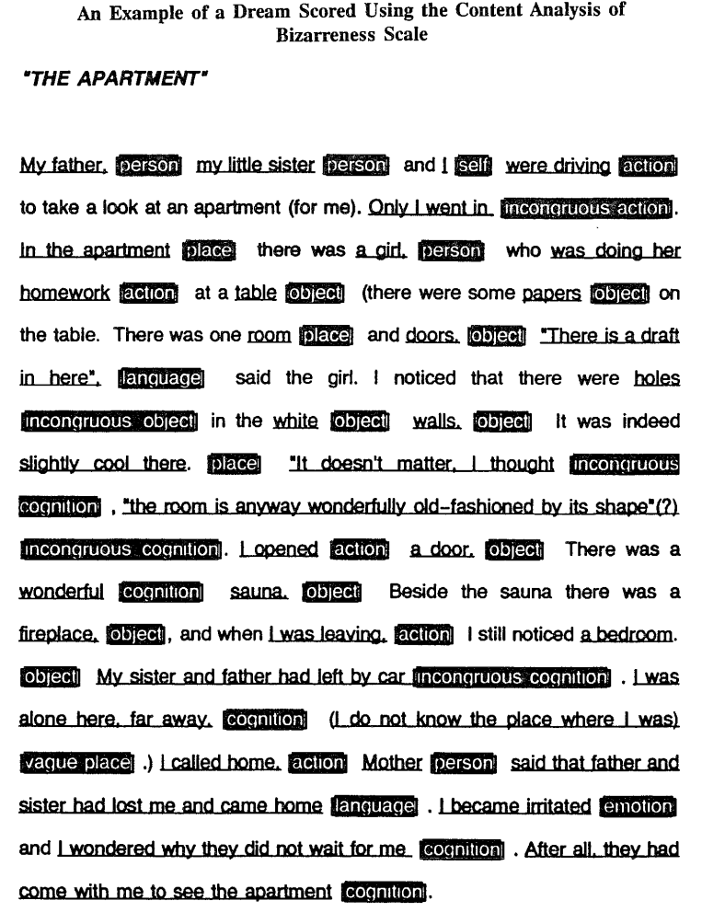

Slide 10
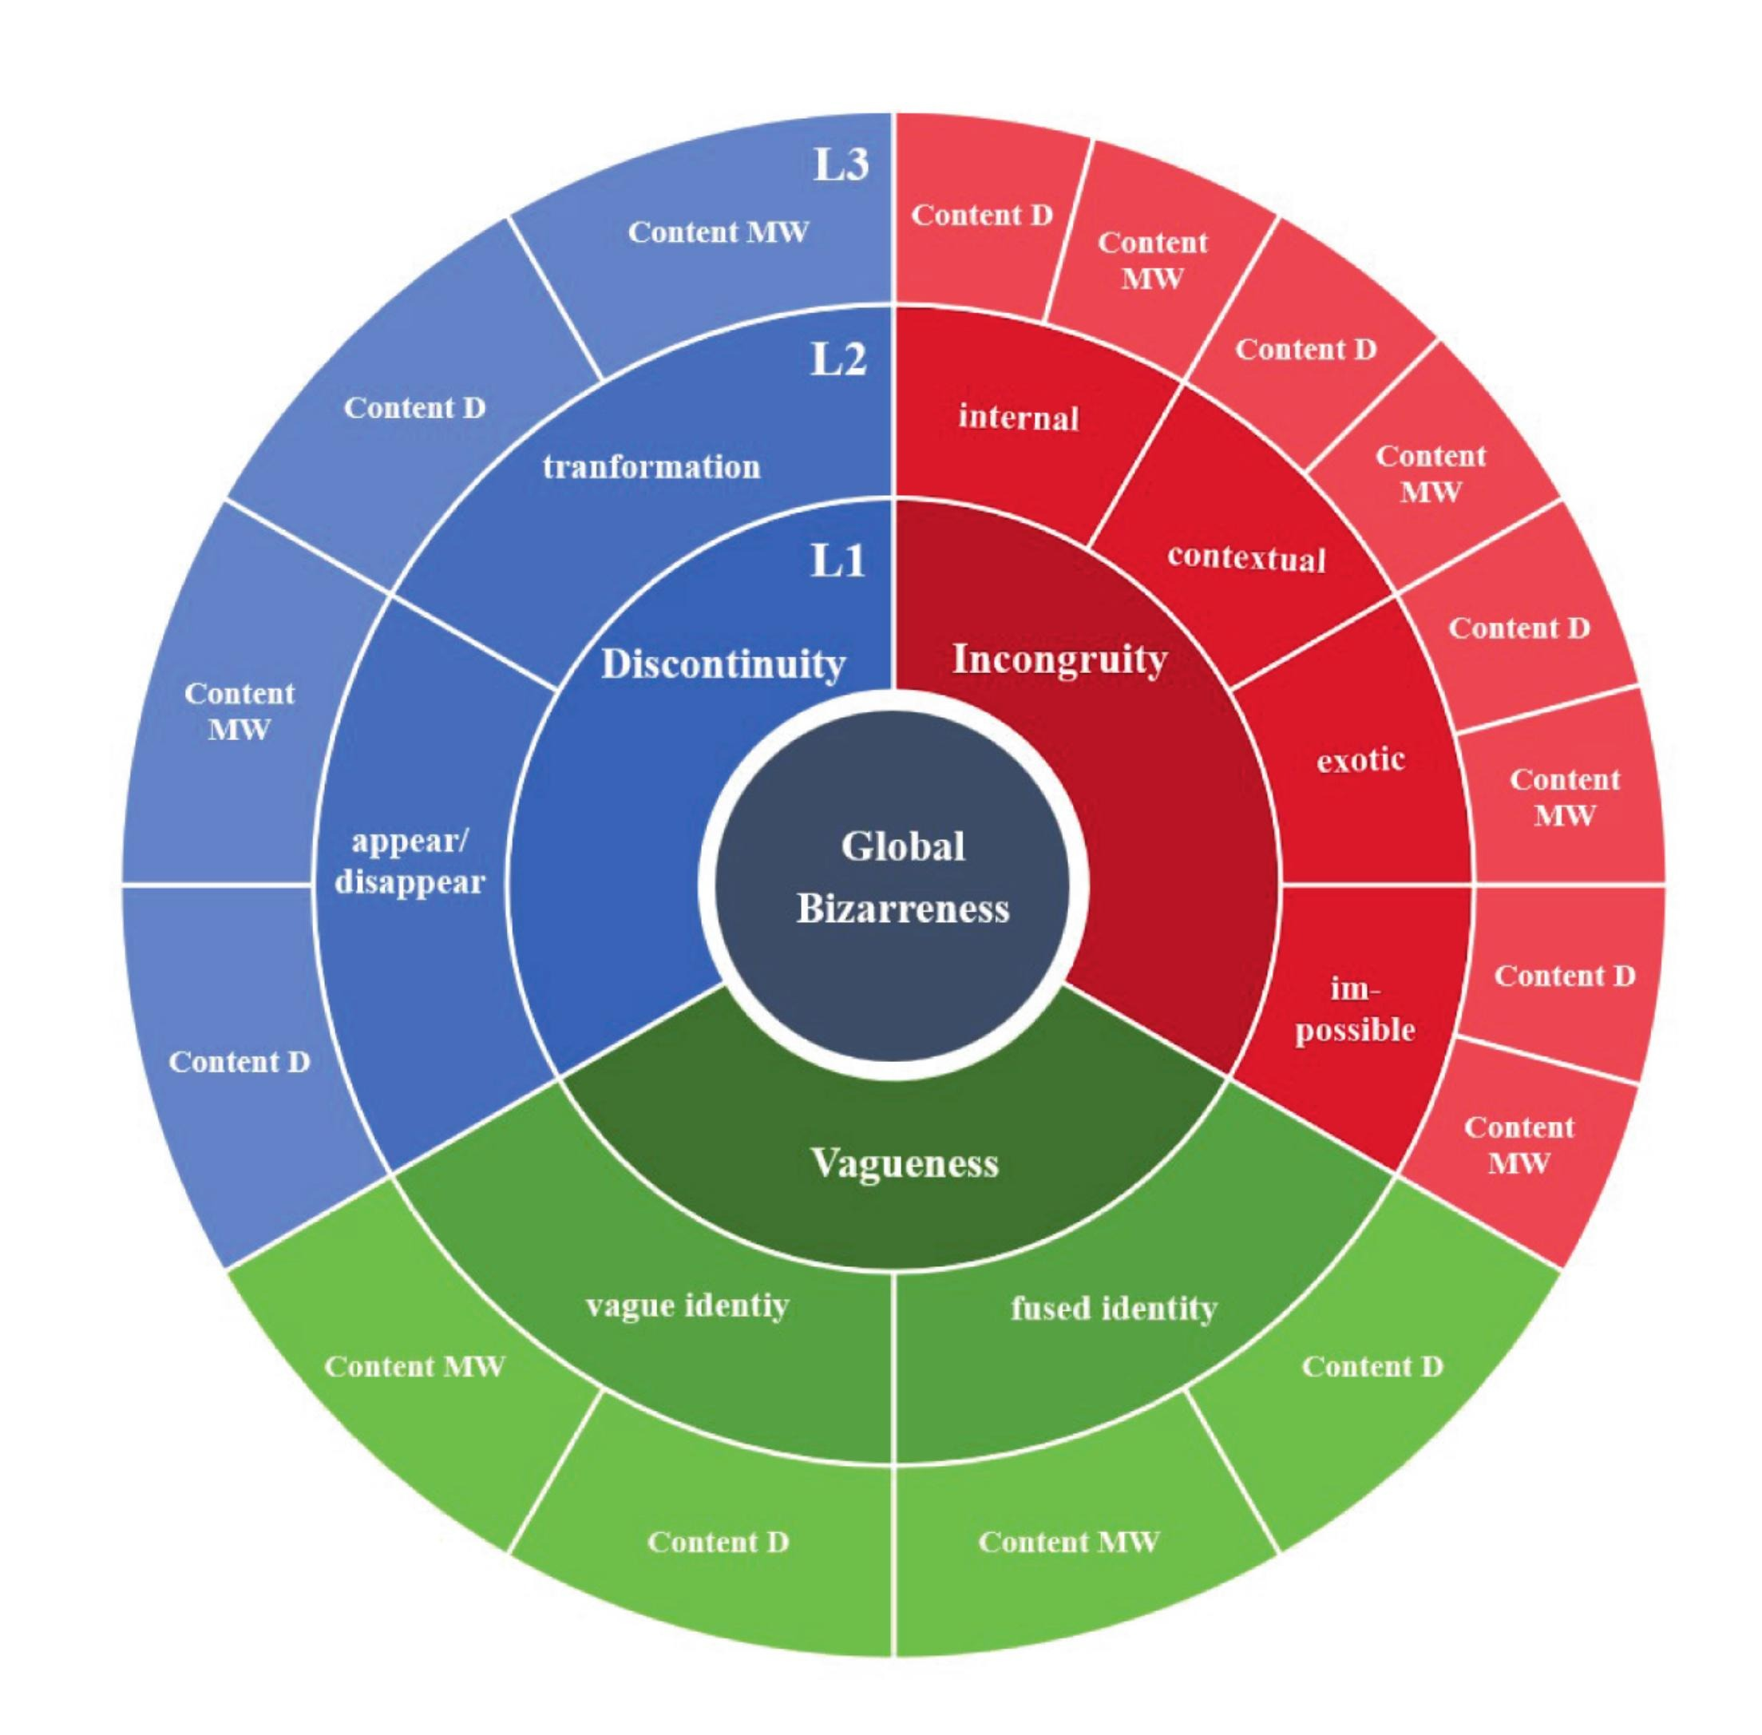
The bizarreness kaleidoscope

Slide 11
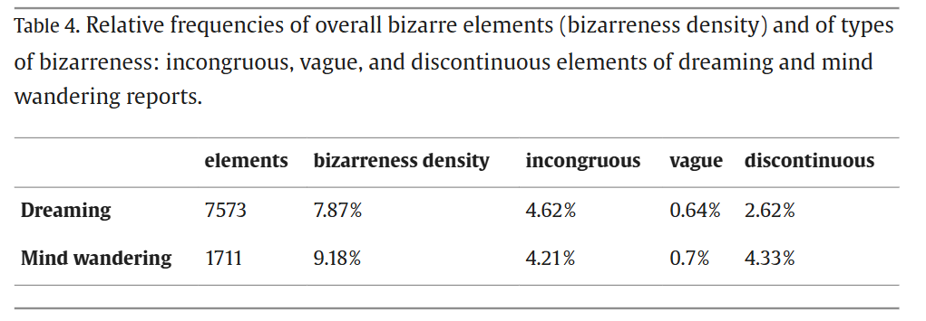
Global bizarreness
In Revonsuo study : 7616 éléments scored with a bizarreness density of 20,7
Others studies can range from 5 % (Snyder, 1970), over 31 % (Schredl, 2010) to 60 % (Williams et al., 1992) of REM dream reports in a sample considered as bizarre.

Slide 12
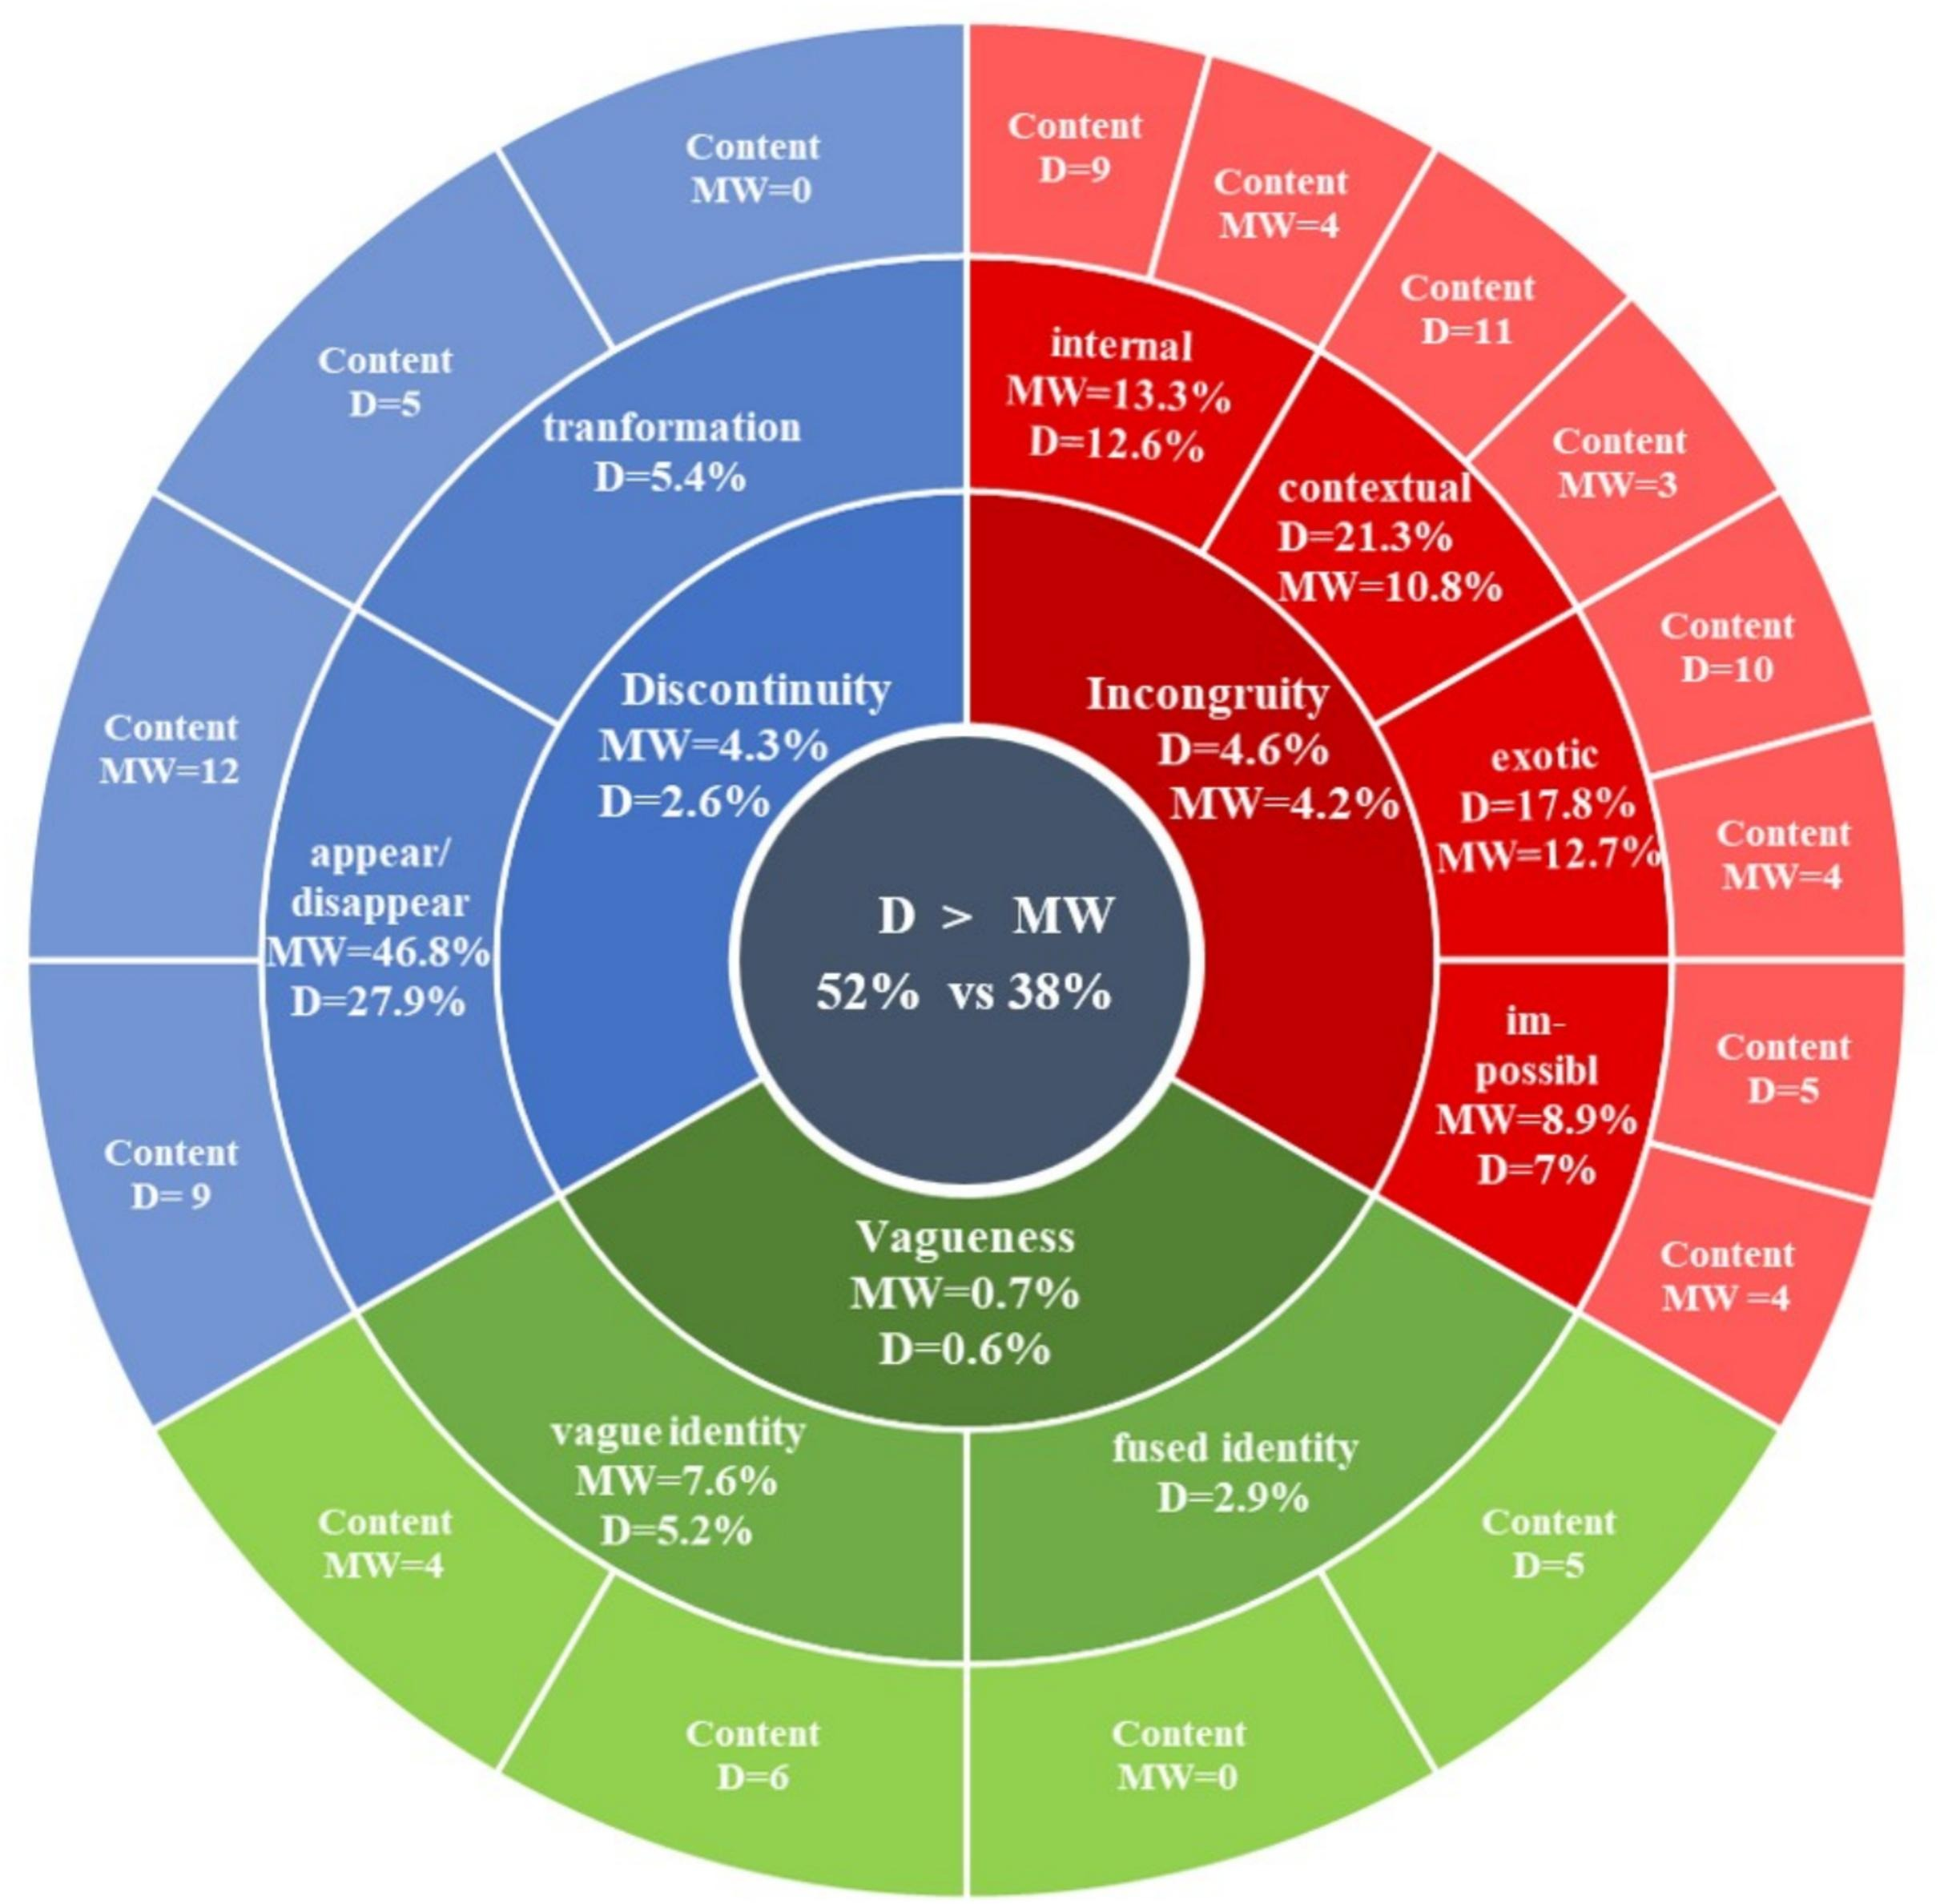
Bizarreness kaleidoscope resulsts

Slide 13
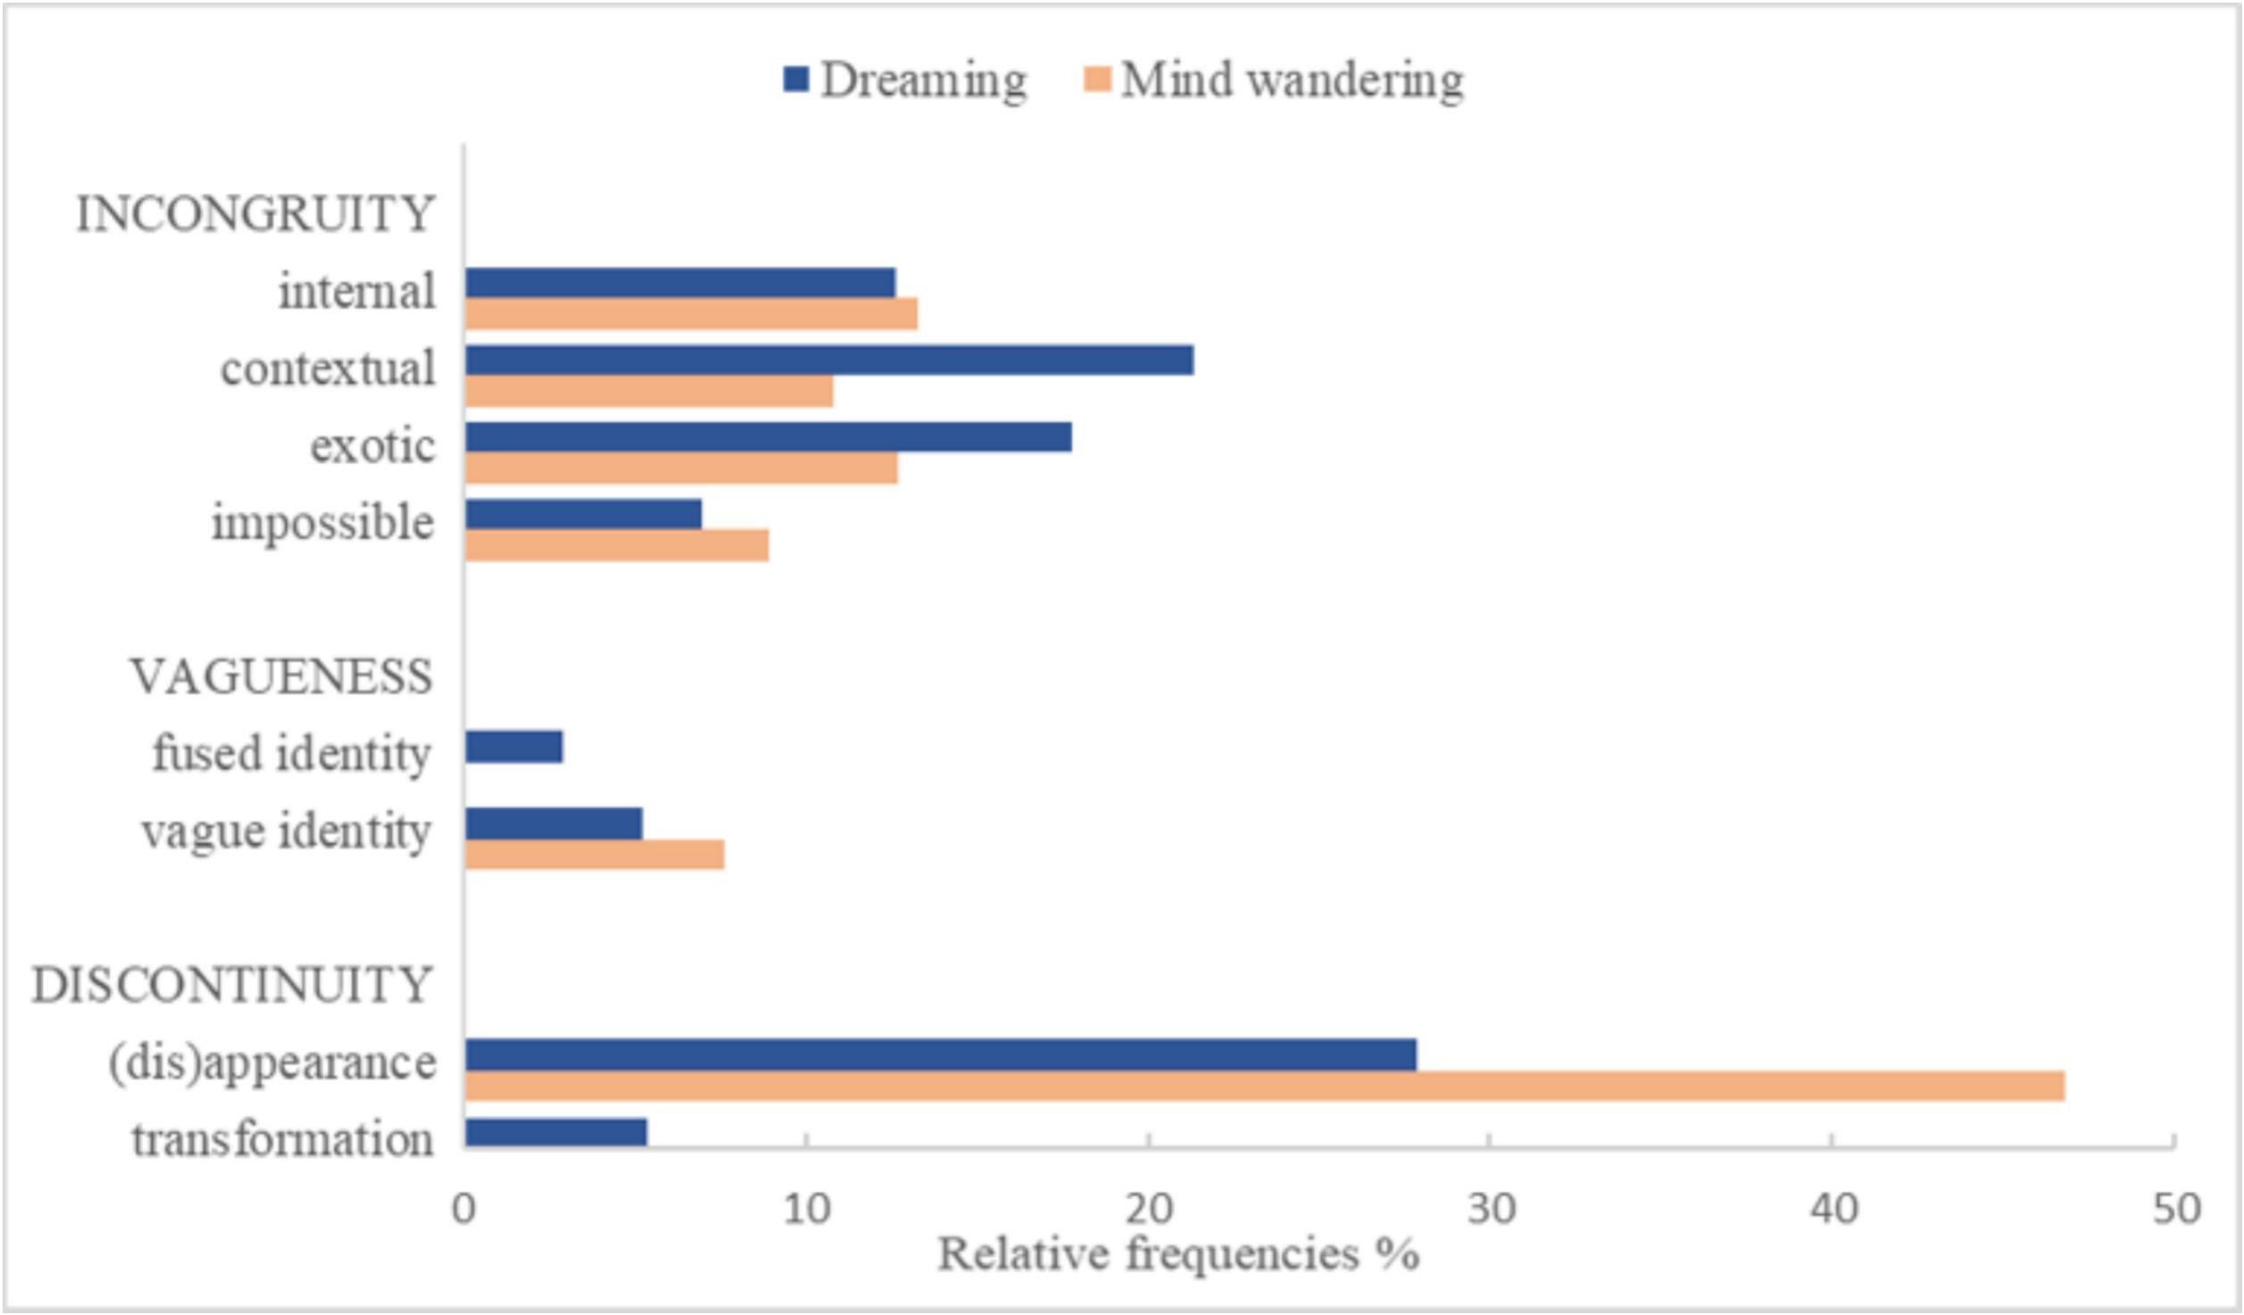
Distribution of bizarreness subtypes

Slide 14
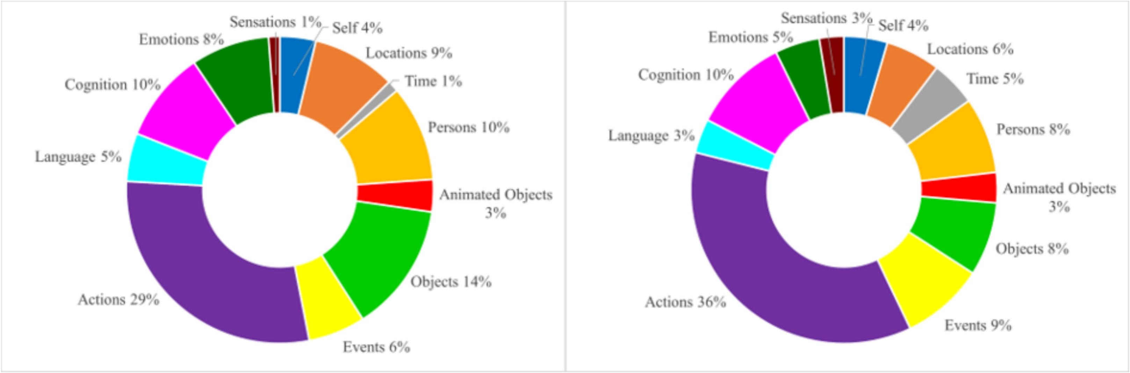
General distribution of content categories
Dream
Mind wandering

Slide 15
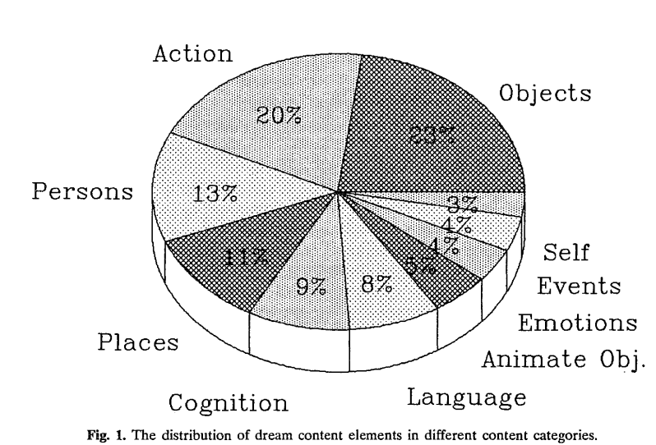
General distribution of content categories
Kirberg et Windt, 2026
Revonsuo et Al,1995

Slide 16
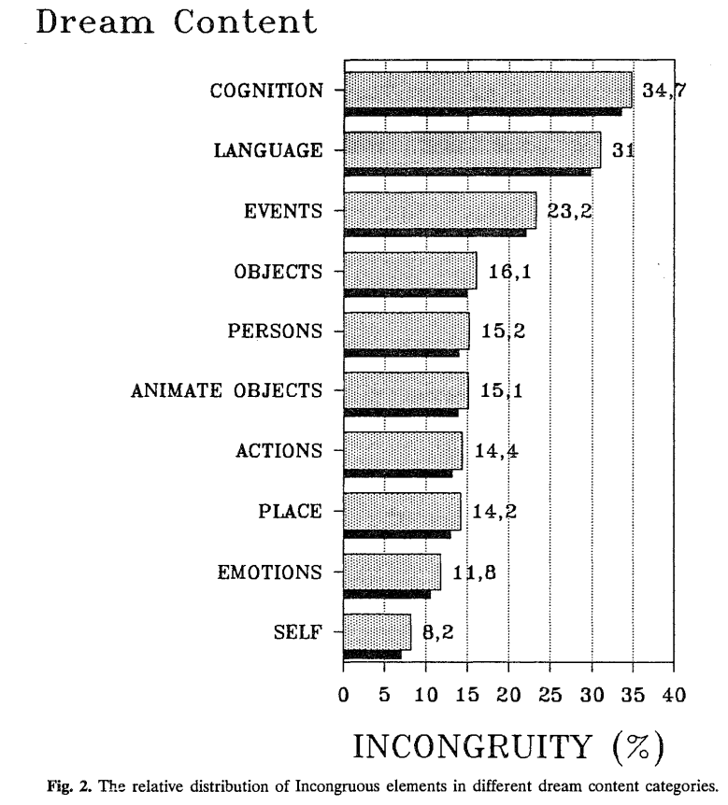
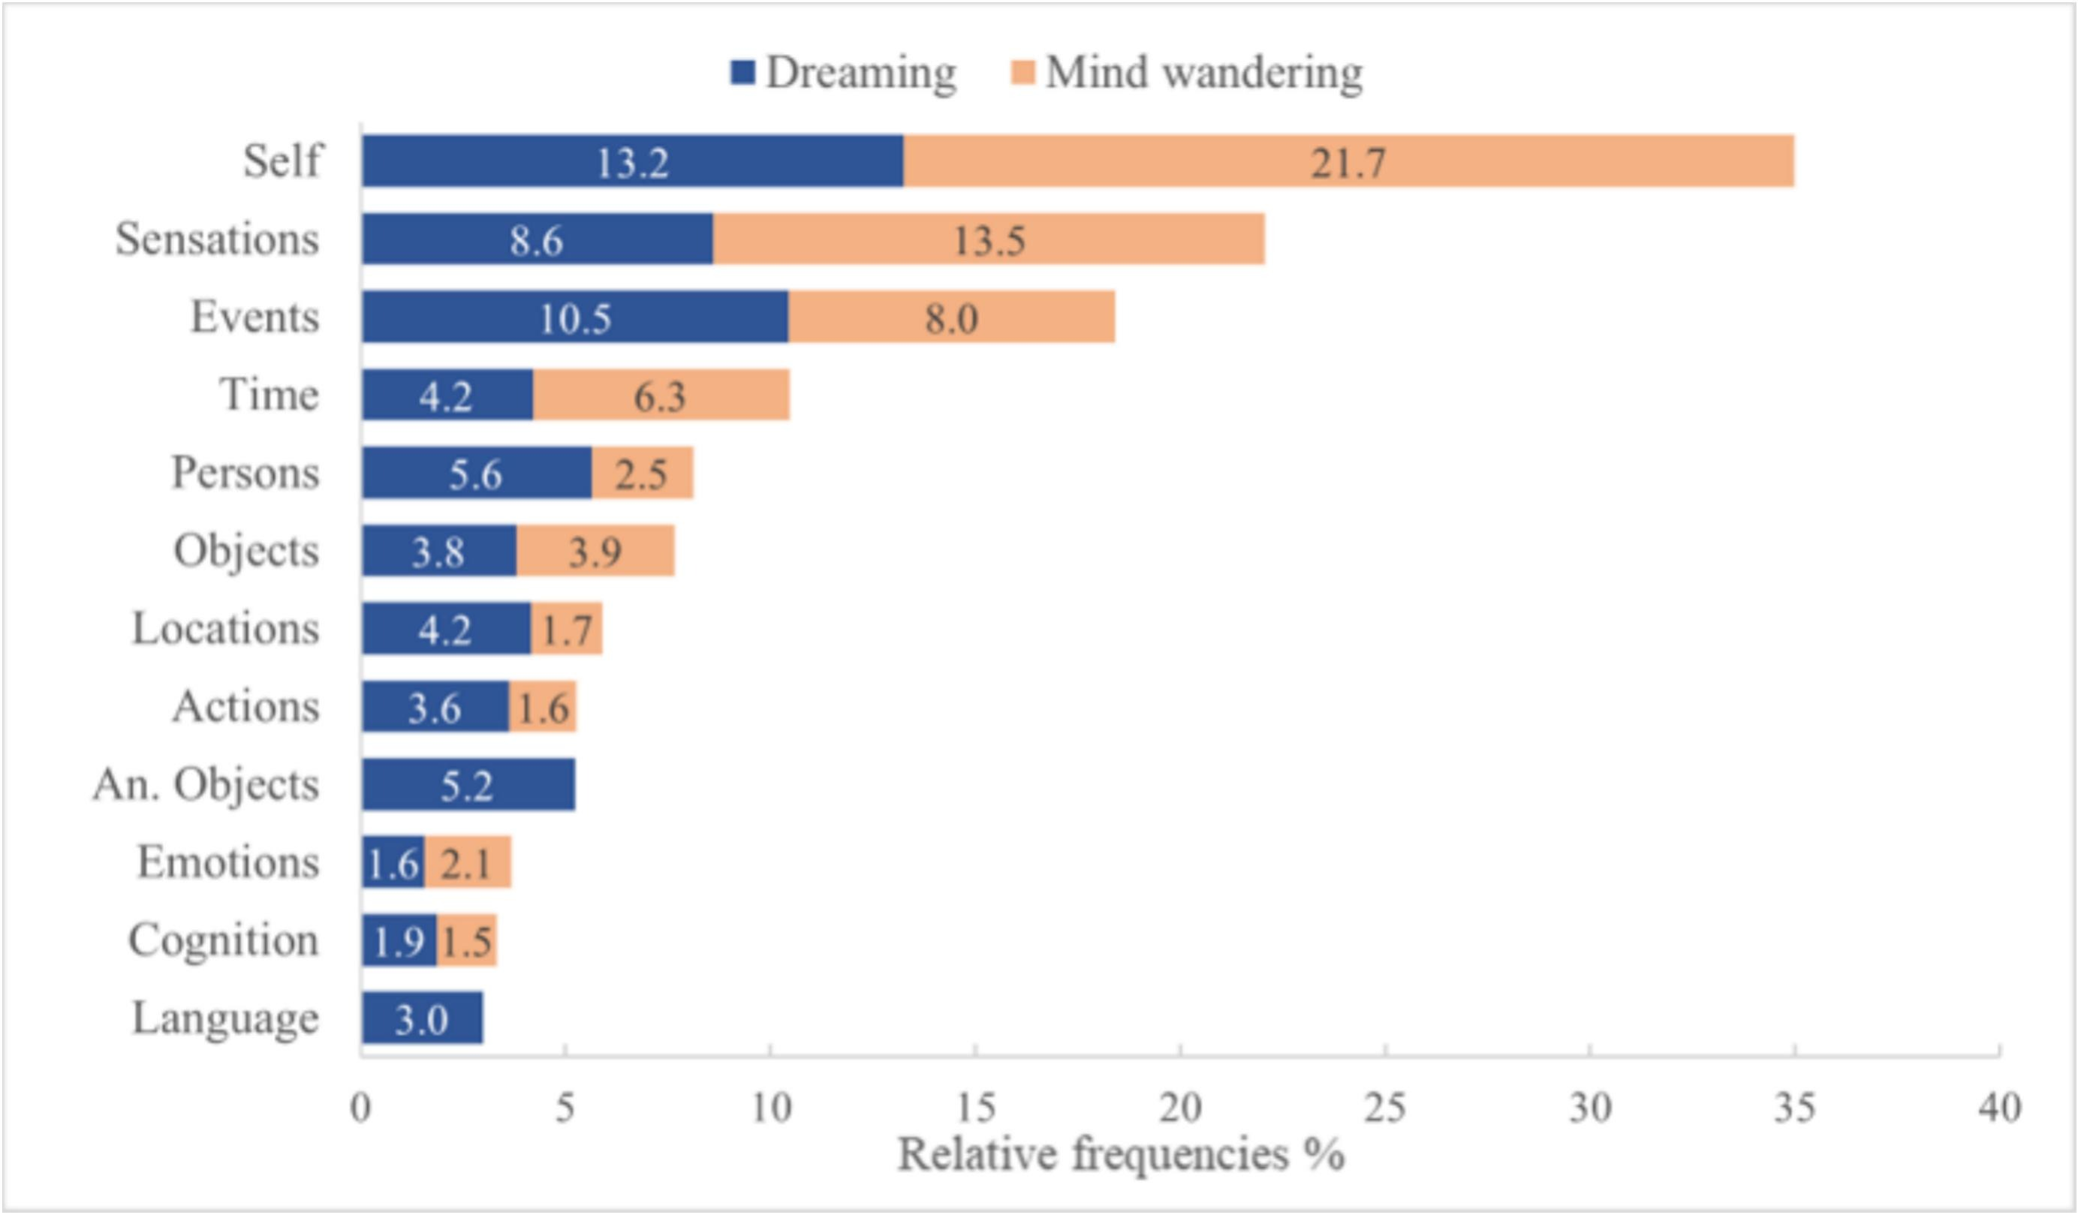
Distribution of incongruous elements in different content categories in dreaming vs mind wandering

Slide 17
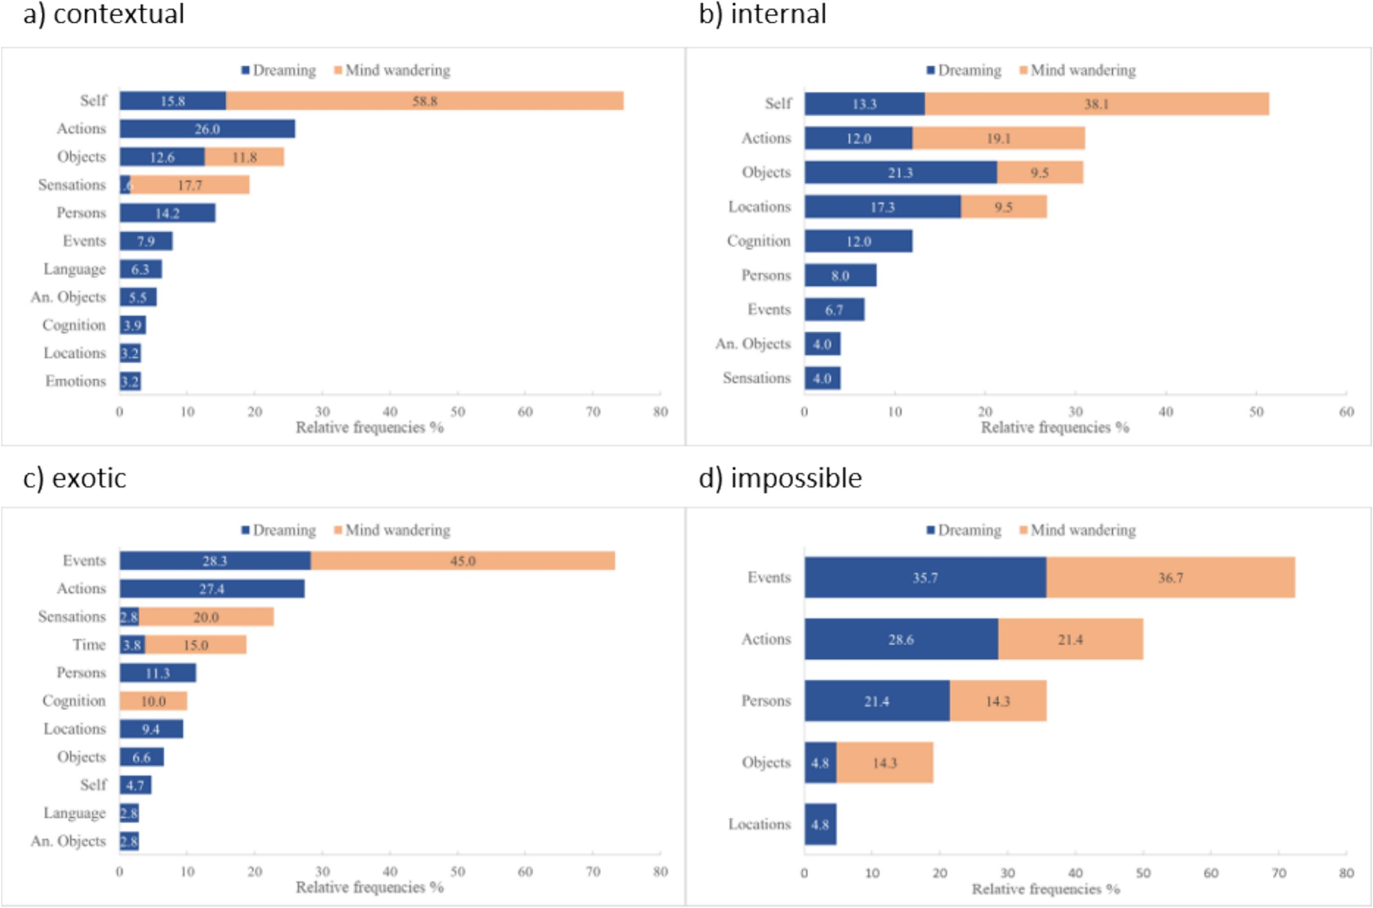
Distribution of subtypes of incongruous elements across content categories in dreaming and mind wandering

Slide 18
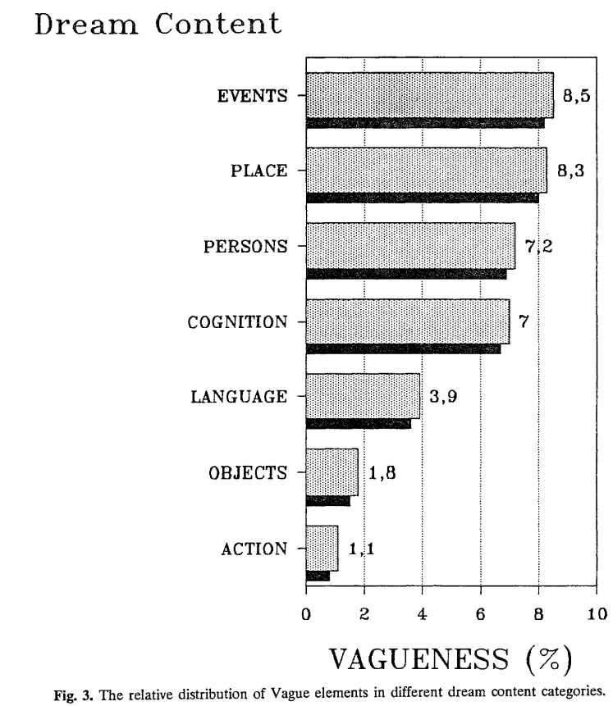
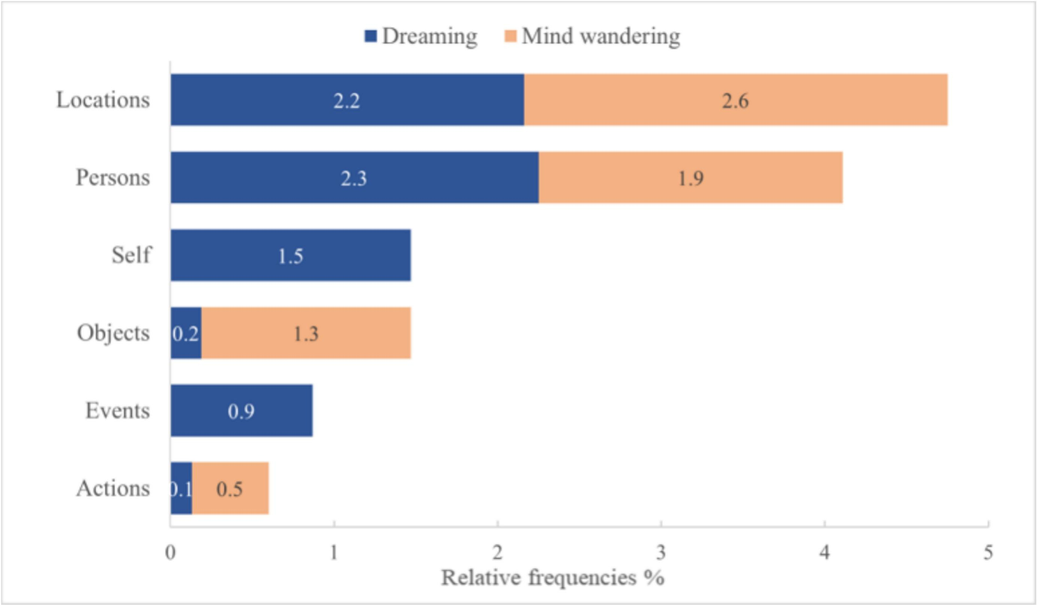
Distribution of vague elements in different categories in dreaming vs mind wandering

Slide 19
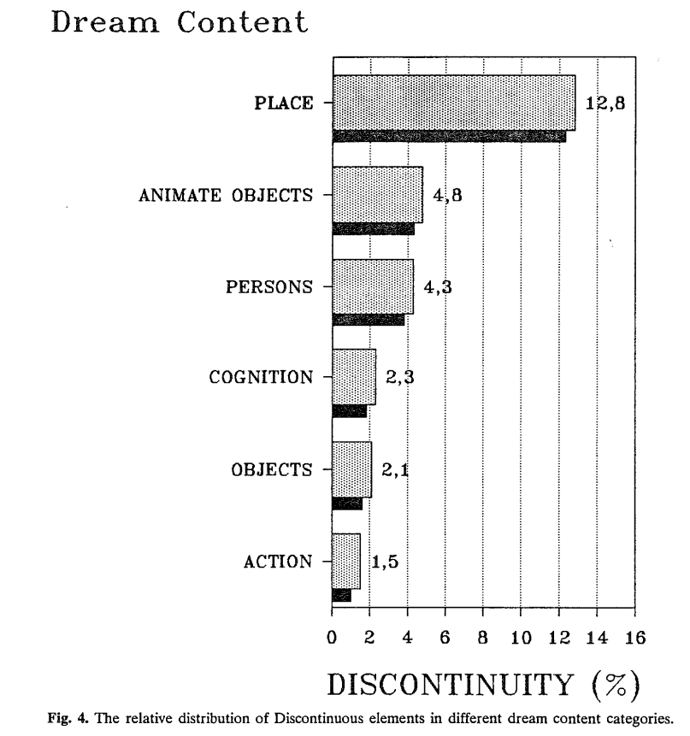
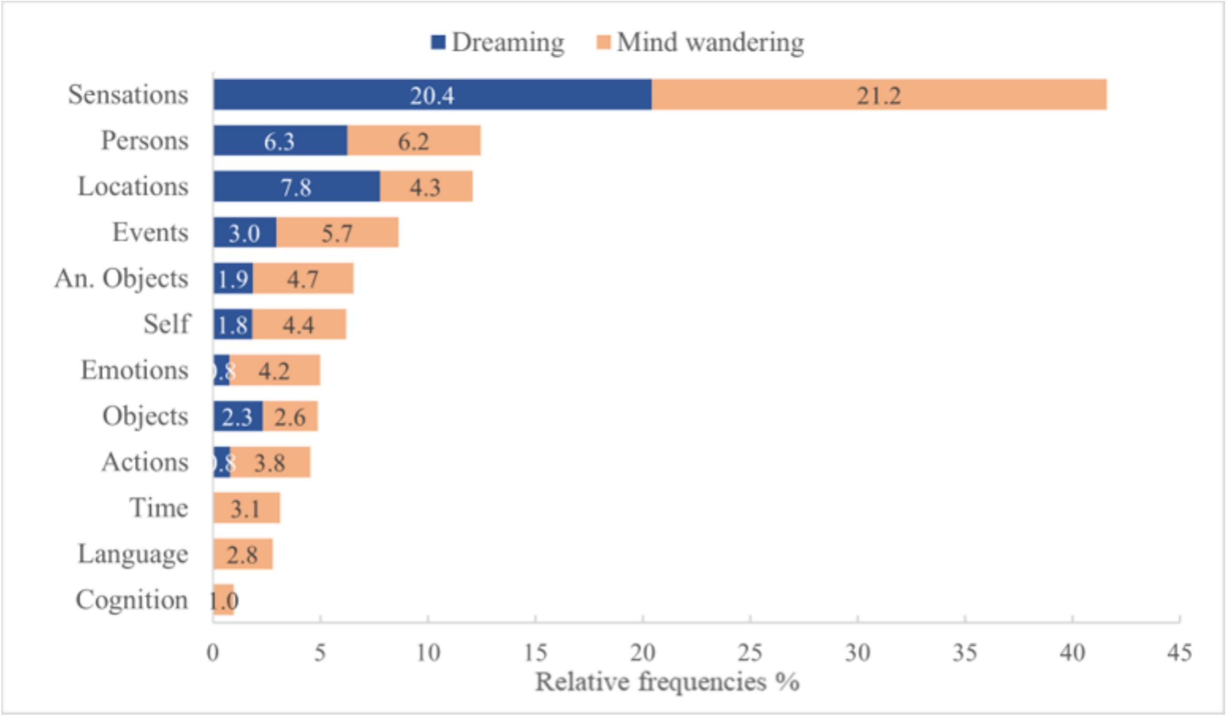
Distribution of discontinuous elements in different content categories in dreaming vs mind wandering

Slide 20
Scoring questions for Manuela Kirberg and Jennifer Windt
Self – What about non-first-person dream or not self-representation perspective
Elements that can be considered as many things (or at least 2) “we” Self and persons.
What about subjectivity or implicit or vague elements where we can score things implicitly which are 99% sure but not explicitly mentioned.

Slide 21
Scoring questions for Manuela Kirberg and Jennifer Windt
Self – What about non-first-person dream or not self-representation perspective
Elements that can be considered as many things (or at least 2) “we” Self and persons.
What about subjectivity or implicit or vague elements where we can score things implicitly which are 99% sure but not explicitly mentioned.
Bizarreness can come from one element and the whole dream will be bizarre due to this element. Doing a tennis match in a guimauve stadium – place is bizarre, but all the actions carried out in this place will therefore be impacted by the place and be bizarre. Do we expect that if this first element carry out all associated bizarreness. If the ball is sticky due to guimauve it’s actually bizarre but not if you consider guimauve stadium as a standard.

